Slide 1



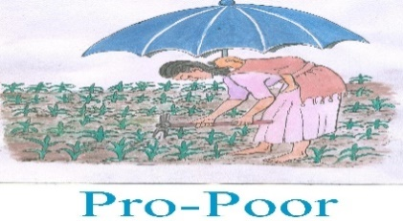


An assessment on the adverse effects of Khat in Young people, Review on the Legal and Policy Frameworks and Possible Recommendations
Validation workshop
By: Aha Psychological Services
October 8 , 2020
Addis Ababa, Ethiopia
Notes:
Redeem the Generation, Pro-Poor Ethiopia Development Organization, Eshet Children and Youth Development Organization
, FSA, Save Your Holy Land Association, Delasalle, Eshet and Pro-Poor

Slide 2
Introduction
Khat use is very common in Ethiopia (4-64.9%)
National prevalence of current use= 16%
People use for different reasons;
  culture,
  recreation,
  self-treatment,
  functional reasons,
  peer pressure and socialization
Associated factors:
  Being young, male
  alcohol drinkers and cigarette smokers
The majority, productive age group , seeds of the country
Khat use is associated with multiple problems of youths
Current khat use at youth age, alter dependency
EPHI STEPS Survey, DHS, 2015, Mihretu et al., 2017

Slide 3
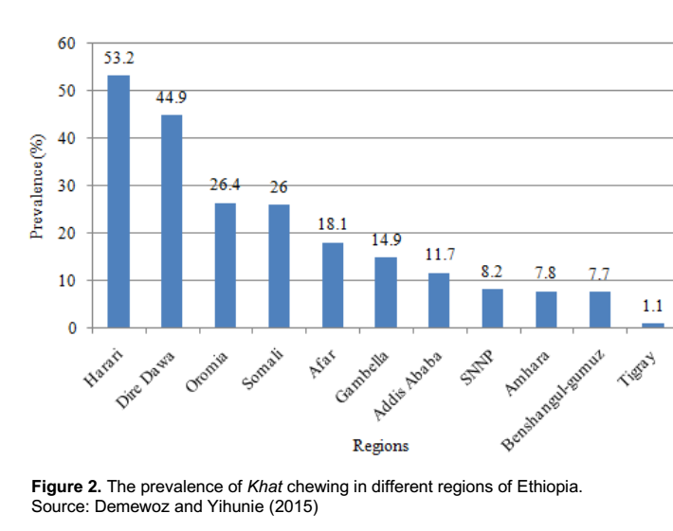
Introduction (2)

Slide 4
Adverse effects of khat use
Socioeconomic
  productivity,
  conflict and crime
  catalyst for other risky behaviors;
  harmful alcohol use and risky sexual behavior
Mental distress
  From common to sever mental illness
Sexual dysfunction, sleep disturbance, depressed mood, lethargy and psychological dependence
Admassie, 2017

Slide 5
Legal/social status of khat use
Illegal in many countries (Europe, North America and Asia) including Tanzania, Rwanda
Habitual use in Ethiopia, Djibouti, Somalia, Yemen, Kenya
In Ethiopia ;
  Different level of political commitment against khat use across regimes
  Few public discussions
  Some level of cultural basis
  Economic attraction
Cochrane , 2016

Slide 6
Limitations of the studies
Generalizability and explanation power
Many are case reports, qualitative studies
Over emphasis on khat use than khat addiction
No comprehensive study
Thus has been unable to inform policy makers
The current assessment is more comprehensive, able to inform policy makers

Slide 7
Objectives of this assessment
To assess the psychological, social and economic adverse effects among Young people (15-29yrs)
To explore the perceived risk of khat for novel corona virus transmission among Young people (15-29yrs)
To review legal and policy frameworks
To assess availability and quality of services for people with problems from khat use
To forward possible recommendations
Notes:
on legal and policy directions, behavioural change, service provision and community engagement.

Slide 8
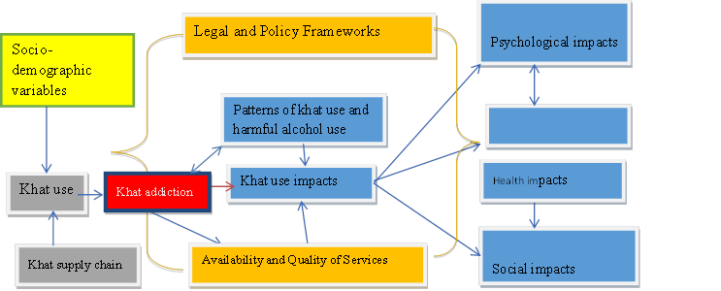
Conceptual framework
Economic impacts

Slide 9
Methods
Mixed approach
Qualitative
  Desk review
  Key Informant Interview
  Group Interview (3 to 4)
  In-depth interview
  Observation checklists
Quantitative (cross sectional)
- Demographic data
- Socioeconomic data
Patterns of khat use
Khat addiction
Psychological Distress
Motivation & purpose in life
Food insecurity
Alcohol drinking and cigarette smoking
Notes:
. It refers to summarizing groups of studies, project documents, reports, and polices /strategies. We also reviewed the 2012 khat excise tax proclamation and the revised commodity excise tax proclamation.
For these, the qualitative tools will address experts/ professionals, program /project coordinators, CBOs, members from taskforce to control substance abuse in the respective regions as well as from federal FMHACA (food medicine and health care administration and control authority, religious leaders, experts from Forum for Social Studies (FSS) and Ethiopian economic association.

Slide 10
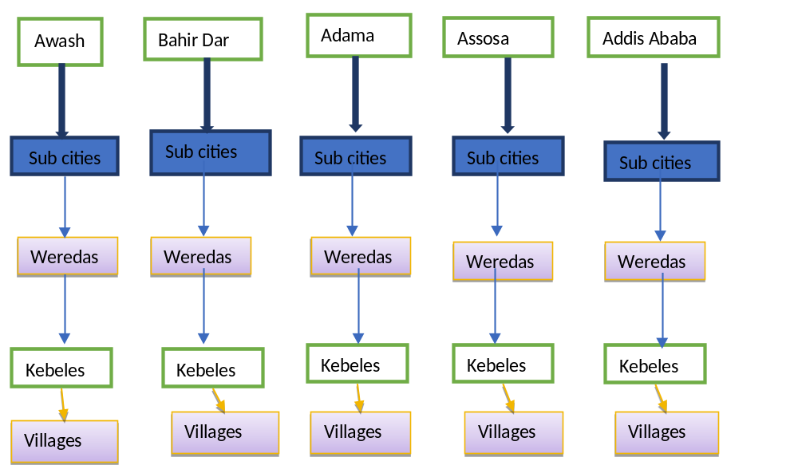
Sampling and sample size
Notes:
Then, woredas, villages / households were be randomly selected from kebeles. Lastly, participants at the household level were be randomly selected when there are more than one khat users.

Slide 11
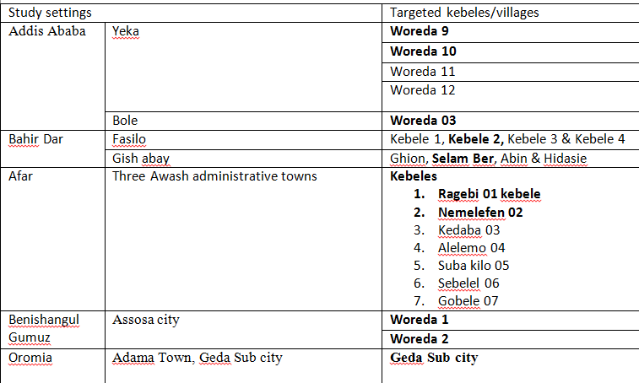
Target study settings and samples

Slide 12
Participants
Quantitative (n=1114)
Qualitative study (n=87)
Youth leaders
Religious and CBO leaders
NGOs
GO officials and politicians
Experts

Slide 13
Data collection and quality assurance
5 core team members
5 supervisors
25 enumerators (5 per city)
Training and supervision
Triangulation
Pretested
Audio-tape recording

Slide 14
Data analysis and presentation
Thematic analysis
Descriptive and Inferential statistics
Use of computer soft ware packages/SPSS-22

Slide 15
Ethical considerations
Approval and letters of cooperation from respective administrations
Informed Consent
Confidentiality
Anonymity
COVID-19 precautions

Slide 16
Results
Socio-demographic reports
  Female= 212(19%)
  PWD= 45(4%)
  Unmarried = 790(70%)
  Divorced =8.6%
  College/TVET and above 156(14%)
  Employed=223 (20%)
Table 1_sociodemographic characteristics of participants.docx

Slide 17
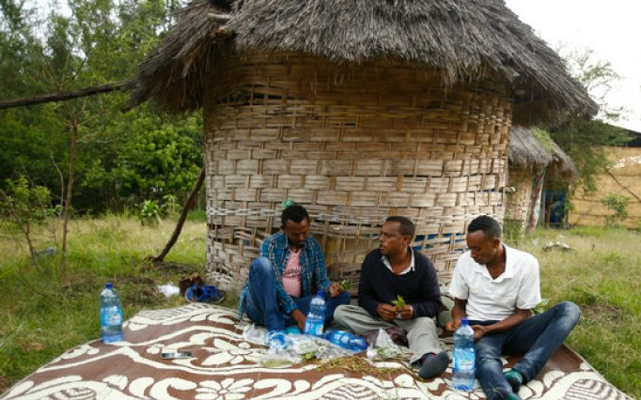
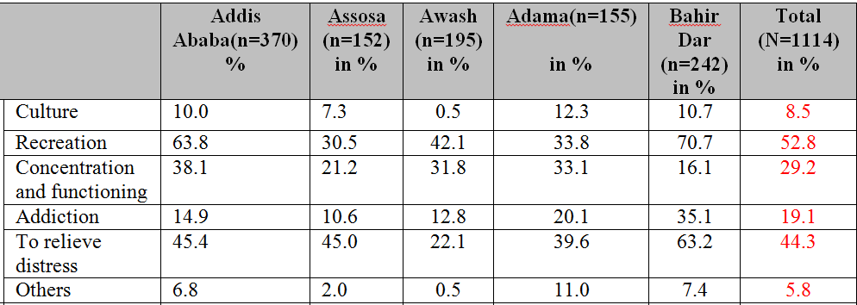
Reasons for khat use
Wrong life style choice/የቃመ ተጠቀመ ያልቃመ ተለቀመ
Peer-pressure
Availability of Khat/where there is no fire there is no smoke
Perceived medical benefits
Curiosity
Parenting style
Suppressing hunger
Notes:
Others: peer pressure, media, wrong socialization, testing

Slide 18
Khat trend across time (1)
  Khat consumption is increasing alarmingly
  Many students chew (8%, excluding dropouts)
  Increased acceptability, but 81% endorsed the harms over the benefits
    Early in the morning when they [youths] wake up, chewing Khat has become a routine, even before doing anything. Police officer, Awash
    Another participant from Addis Ababa said;
  for us, Khat is like a bread or ‘Shiro’.
  A youth from Adama

Slide 19
Khat use across time (2)
In past time, Khat use among children was a taboo. Females could not also touch Khat. Now days, it is common that 15 years old youth chews Khat but in former time it was taboo even for 25 years. Now females are also engaged in Khat use and sales. In past, only elderly people chew Khat for prayer-duwa purpose, but now everyone chew Khat for different reasons. Amazingly, there are also places called Khat center/Khat tera designed for Khat sales.
One community representative / elderly from Assosa

Slide 20
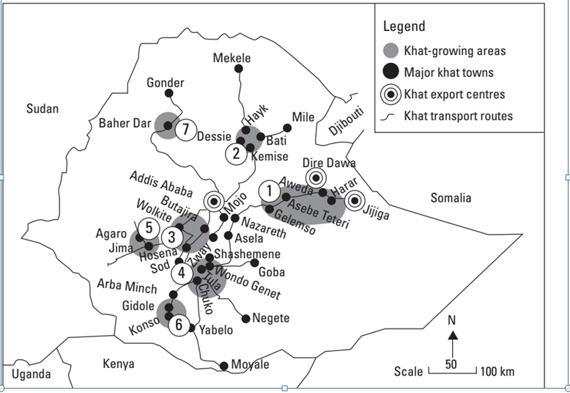
The current trend of khat (Gebissa, 2015)

Slide 21
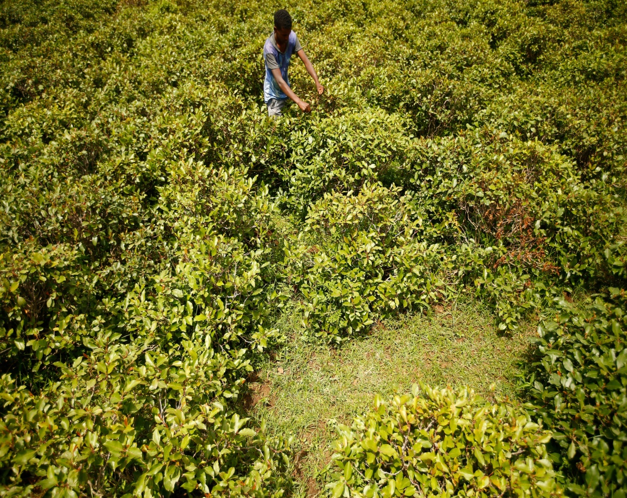
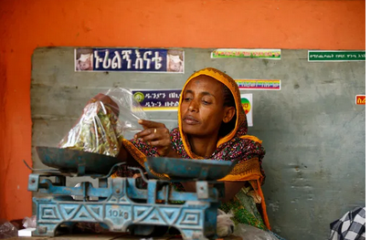
Khat supply chain

Slide 22
Social Impacts of khat use (1)

Slide 23
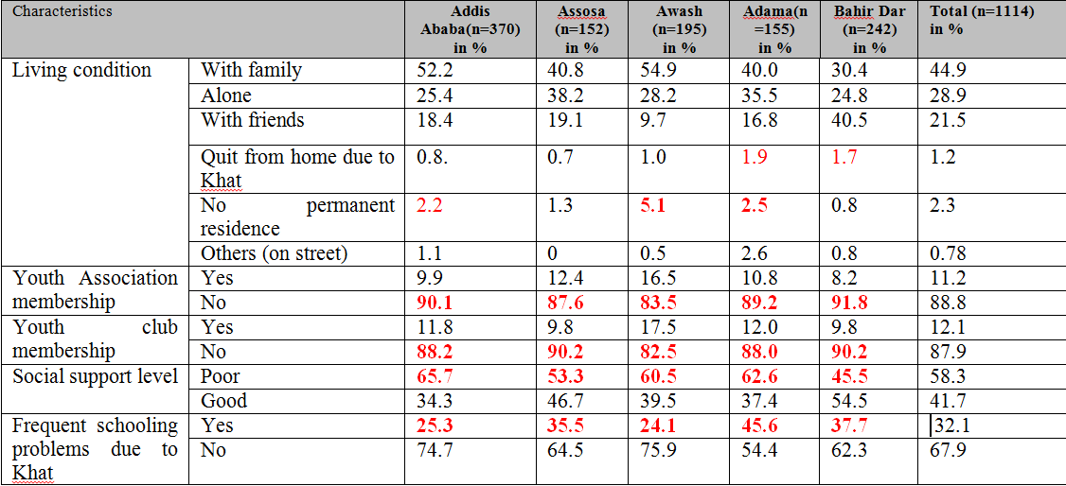
Social problems per towns

Slide 24

Social problems (2)
Crime
Last year, there was an incident committed by an addicted youth who killed 6 people including his mother without any valid reason due to Khat and shisha which made him to lose his judgment and consciousness.
(A police participant from Assosa)

Slide 25
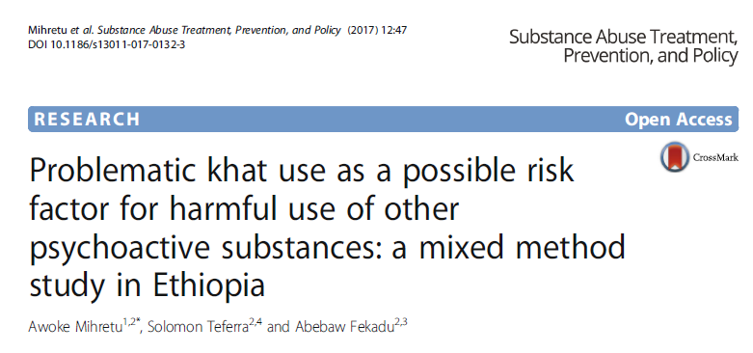
Other psychoactive substances use
“Khat is a catalyst for many things/
ጫት አቃጣሪ ነዉ”

Slide 26
Psychological distress

Slide 27
Psychological problems
Narrowed/absence of meaning and purpose in their lives=13%
loss of energy for work =26.7%
depression symptoms =21.7%
sadness =16.7%
restlessness =16.2%
nervousness =15.4%
hopelessness=13.4%
-Other studies
Depression and anxiety
poor confidence
Sexual dysfunction
sleep disturbance
(Etana, 2018). (Alem, Kebede, & Kullgren, 1999; T. Damena, A. Mossie, & M. Tesfaye, 2011).

Slide 28
Prevalence of Anxiety/depression across regions

Slide 29
Economic Impacts
“I know someone whose wife can’t eat food even once per day but the husband chew khat daily.” religious father, Bahir Dar

Slide 30
Economic Impacts(2)
48% expense from their income
In another setting, 1,800 ETB (30% of their income)
Spend 112.5 hours monthly
Negatively associated with the work culture(leave for lunch break early and come back to work late).
Gudata, Cochrane, & Imana, 2019

Slide 31
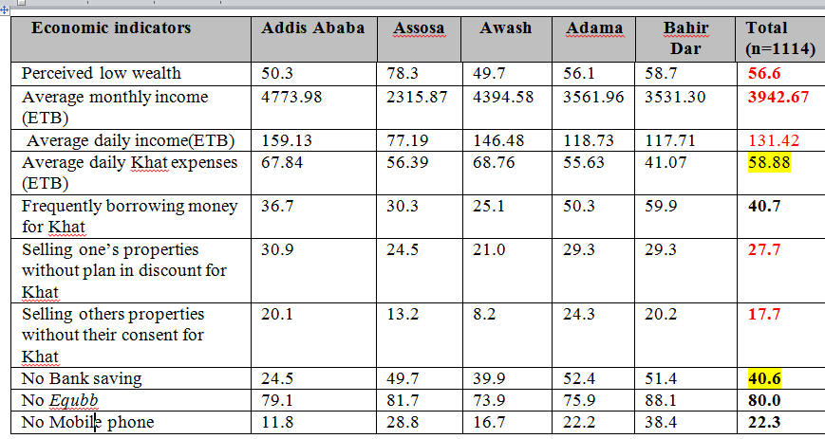
Economic impacts across regions

Slide 32
Food Insecurity

Slide 33
Food insecurity (2)
Food insecurity, study from Sidama (Etana, 2018).
- displacing staple food crops and disempowering women(Dessie & Kinlund, 2008).
Khat as an appetite suppressant.
Khat, as a cash crop
outcompetes other crops, including coffee, primarily due to its fast growth (2 to 3 times harvests per year),
stable and lucrative income, and better resistance to shocks (e.g., drought, price fluctuation)(Dessie, 2015).
- For example, a Khat farm on a 0.1 ha plot in Wondo Genet can generate 25 times and six times more income than maize and sugarcane, respectively(Dessie & Kinlund, 2008).

Slide 34
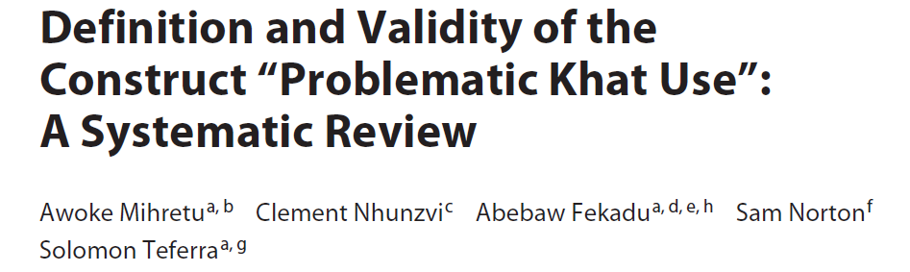
Khat Addiction : National and per towns

Slide 35
  Relationship among some variables
Khat addiction and psychological distress doesn’t vary across gender
The difference in mean scores for
  Khat addiction
  food insecurity
  social support and psychological distress among the study settings was quite small.

Slide 36
COVID-19 and khat use
Impacts
Worry related to the impacts
Depressed mood related to social distancing
Reduced productivity
Risk Perception
Chewing together
Touch
Crowd markets
Inability to stay home and chew alone
Khat production
Risk of Infection
Khat consumption

Slide 37
Prevention measures for mitigating COVID-19
Doing nothing= 15%
Plan to quit chewing= 3%
Chewing alone= 29%
Chewing with physical distance =50%
Washing the khat= 30%
Hand washing= 47%

Slide 38
Perception of Susceptibility
Low immunity related to poor diet | 5.8%
Can’t be in physical distance | 15.3%
Not using face mask when chewing with others | 13.4%
People touch the Khat | 32.1%
Sharing Khat from others | 5.7%

Slide 39

Rehabilitation Services
Only at the capital and closed during the pandemic
BGDAN under CSSP I fund had done successful rehabilitation
Gaps in quality standards against EFMHACA service especially about occupational therapy
Assosa Rehab center

Slide 40
Legal and policy frameworks/harm reduction
Cathine and Cathinone main ingredients of khat are under international control
Different initiatives for law regulation; RTG/Ips, CSSP, FSS, EPHI
Amhara regional state has been discussing to set law regulation
There are plans to curve khat use under MoWCYA, MoH

Slide 41
Strategic plans
The MoWYCA and Benishangul Gumuz strategic documents reads;
  awareness creation about the effects of Khat in the curriculum
  Providing trainings about the negative effects of Khat
  Reviewing current rules and regulations about psychoactive illegal drugs, amending them if needed and formulating new ones.
  Lobbying different stakeholders in using and strengthening the existing youth and rehabilitation centers and the once that are available in hospitals.

Slide 42
  Conclusion
Increasing trend of Khat use in the study settings; and its increment is fast
Many youths are engaged in Khat use
Multidimensional adverse effects of khat
  Psychological= 19% sever level
  Social = 33-58%
  Economical= 48% of their income is spent for Khat and related expenses
  About half of the study participants have food insecurity
  Khat addiction prevalence among Young people was 31%
  There was significant association between khat addiction with psychological distress and food insecurity
Khat is also a catalyst for the transmission of the current COVID-19 pandemic.

Slide 43
  Conclusion (2)
Limited rehabilitation services
Khat and Khat use regulation rather than ban was suggested as the most effective policy in Ethiopia

Slide 44
  Recommendations
Behavioral change
  Continuous and evidence-based education and awareness programs using effective strategies
  Education, awareness and training could also be integrated in non-curricular activities in schools and universities
  The government should break the silence and explicitly state about the multidimensional harms of Khat use using different platforms

Slide 45
Recommendations (2)
Services
  Holistic, Youth oriented approach and accessible
  MoH design screening tools and protocols for the treatment of Young people with khat addiction
Community engagement
  Family level programs
  community resources exploration and integrate with modern treatment
Notes:
Evidence on community intervention

Slide 46
Recommendations (3)
Law regulation than full ban
  Khat production
  livelihood alternatives
  Investment and commitment on candidate law enforcement
Khat trade
  Excise tax
Khat consumption
  Specifies the minimum age limit for Khat use
  Partially ban at some places
  Restrict Khat vendors
  Avoid any promotional activities of Khat trade and Khat use
  Prohibits Khat advertisements
  Khat transportation
Multi-sectoral/coordination
More research to provide evidence
Notes:
If the government continues to export Khat; Khat growing areas (farms) should be designated separately and who, how, when to grow it and the damage it is resulting on the generation has to be considered.

Slide 47
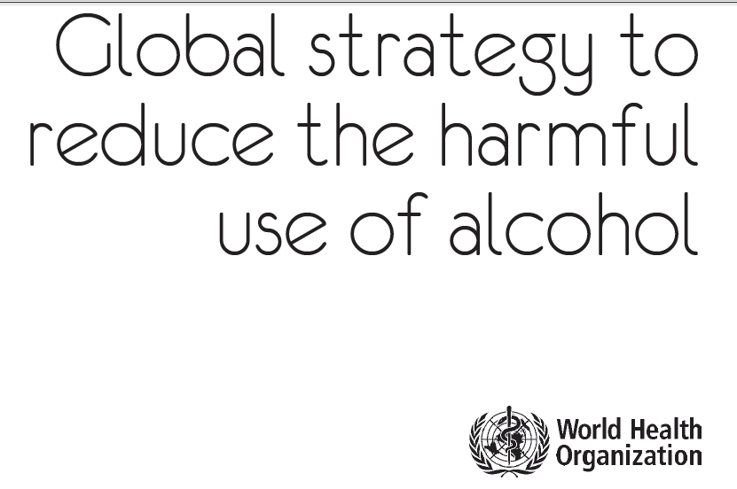
Lessons from other drug harm reduction measures
Policy –lion share for harm reduction
  Increase in purchase prices
  Reducing affordability
  Taxation
  Setting minimum prices on alcohol
  Ban products that are likely to attract the vulnerable
  Minimum drinking age
  Limiting the blood alcohol concentration for drivers
  Create more awareness
  Limiting access
  Limiting days and hours of sale

Slide 48
Lessons/experiences about khat harm reduction from you???

Slide 49
Thank you

