Slide 1




Pro Poor Ethiopia Development Organization
( PEDO)
Annual Report
15/01/ 2025
Addis Ababa
With support from:

Slide 2
Executive Summary
Pro- Poor Ethiopian Development Organization (PEDO) was established in June 2003 with the vision “regenerating, hope and self-esteem” for the hopeless and the disadvantaged sections of the community. Based on the new CSO law, it was reregistered as Ethiopian Resident Charity Organization It is implementing a project entitled as Youth Leadership and Engagement Access for Development (Y-LEAD) in Bensishangul Gumuz Regional State of Assosa town administration woreda1 &2. The project duration is from 01 Feb 2024- 30 April 2026.

Slide 3
Project information
Project Name: Youth Leadership and Engagement Access for Development (Y-LEAD)
Intervention area: Assosa Town woreda 1& Woreda 2
Duration of the project: Feb,01,2024- April,30, 2026
Total Budget allowed----------1,768,005.00
Utilized : --------------------538,366.85
Remained : ------------------1,229,638.15
Percentage-------------------30%

Slide 4
Cont…
Direct Beneficiaries
Male:--------------------2000
Female:-----------------1000
Total:---------------------3000
Dis ablities
Male ------------------------15
Female -----------------------15
Total----------------------------30
Indirect beneficiaries-:----5000 including dis abilities& venerable youths

Slide 5
Objectives
General Objective:
To contribute to the general wellbeing of youths.
specific objectives:
To advocate policy makers and stakeholders for the approval of the draft proclamation for khat control and for establishment and strengthening of services for victim and survivors ,
To identify and establish start-up business for vulnerable and survivors of substance abuse ,
To improve stakeholders and community engagement on the adverse effect of substance abuse among the youth and the society people to amplify their voice to government, policy makers, and community members so as to demonstrate positive change agents,
To capacitate and support young people to be active citizens and engage in peace building, conflict prevention and violence protection,

Slide 6
Plan Vs Achievement
1.1. Conducting evidence based research
  PEDO have been Captured/collect evidence on the adverse effects of substance abuse on young people a case study of targeted project area of Assosa town in collaboration with Aha Consultation P.L.C. This helps us to present the finding of the research to the general public and policy makers about the adverse effects of substance abuse on young people:

Slide 7
1.2. Conduct action research about youth and peace in collaboration with youth clubs to identify their common concern and increase engagement (TBD)
We started a proses with Assosa University to conduct action research to identify their common concern and increase engagement at peace building and conflict resolution as well ass social and economic participation at the two woredas Assosa ton administration of 3 selected ketenas.

Slide 8
1.3. Conduct participatory video trainig and consultation meeting
We have been conducted participatory video training and consultation meeting how to establish addiction rehabilitation center, to prevent the effect of khat and it’s associates on youths and the general public as well as how to ban khat and it’s associate local laws. During the training , male 15, female 10 t0tal 25 participants attended at the training program july 27/2024. were We established addiction rehabilitation creation committee at Assosa town administration level. The committee has 7 male and 2 female a total of 9 members from different concerned sectors, The committee is by Assosa town administration vice mayor. The committee prepared an action plan .

Slide 9
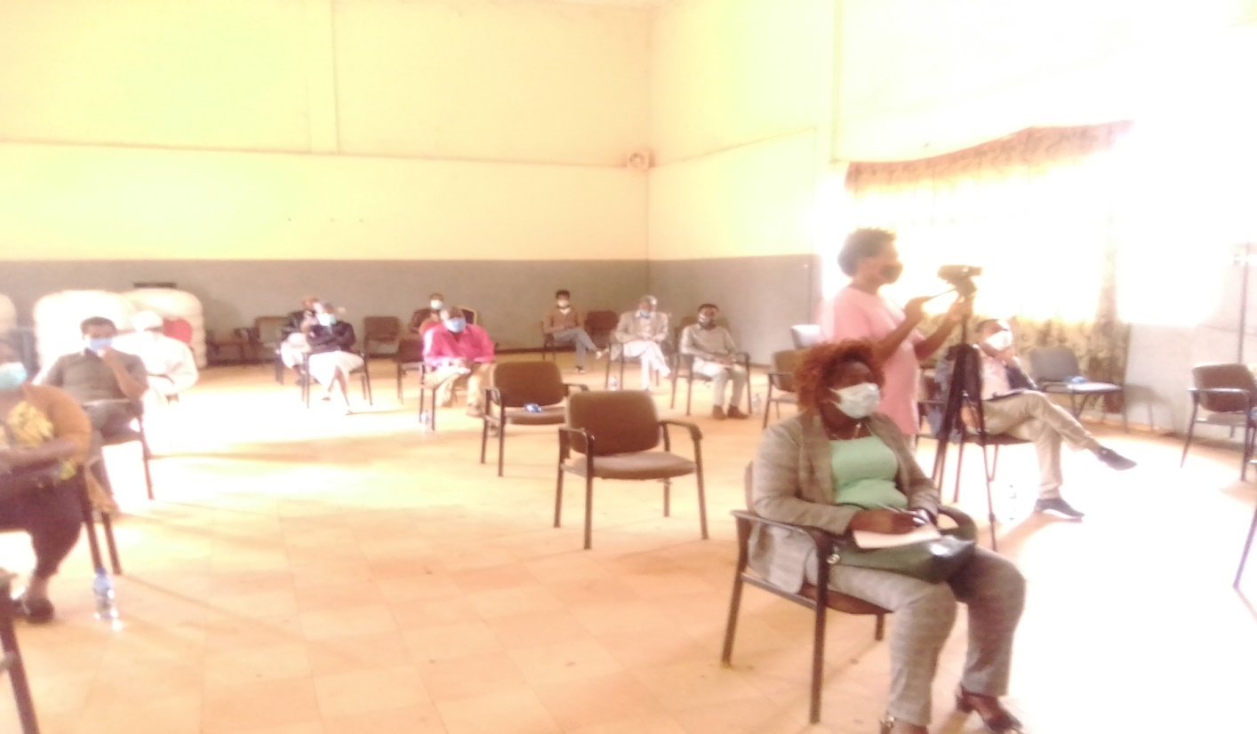
Cont…
Image 1.1 PV &video production training

Slide 10
1.4. Establish addiction rehabilitation service improvement center( Committee Joint action plan
were We established addiction rehabilitation creation committee at Assosa town administration level . The committee has been prepared joint action plan to conduct the following activities,
To improve youth recreational centers & addiction rehabilitation c enters
Adopt community by laws of ckat and associate drugs
To minimize the negative effect of ckat and associate drugs

Slide 11
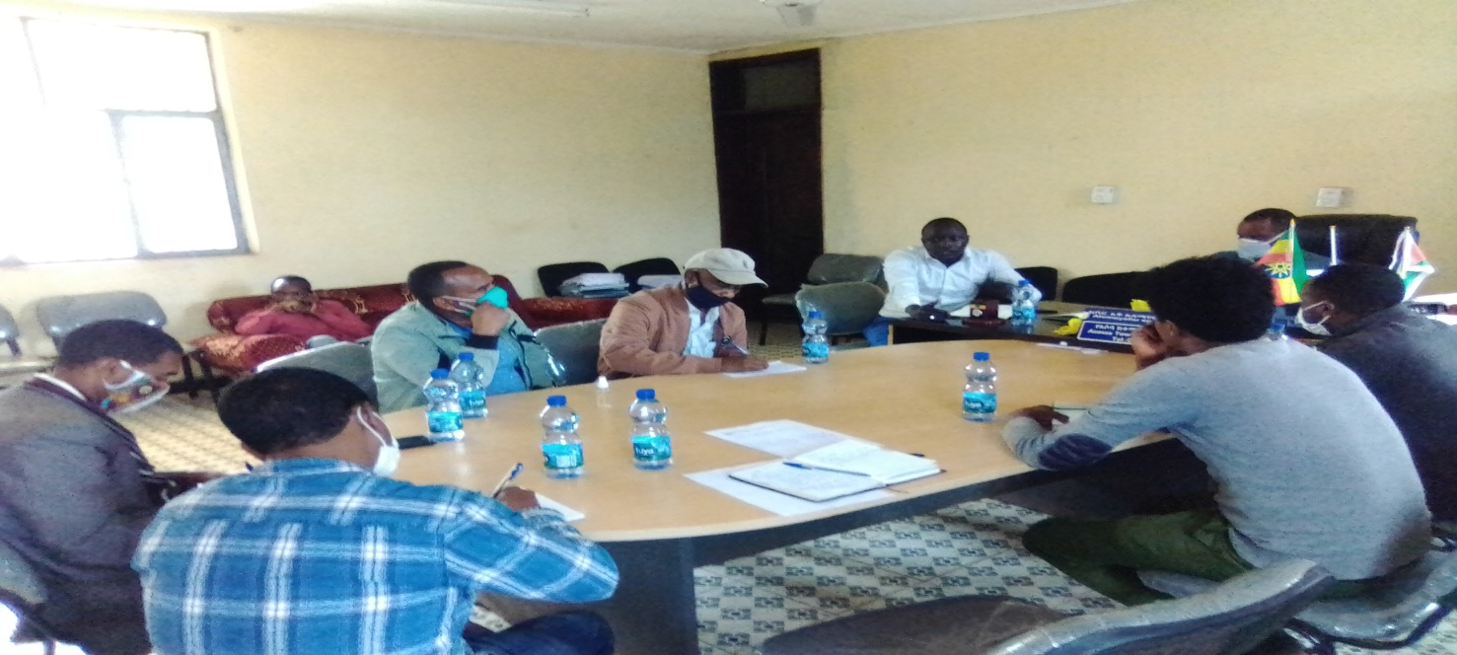
Image1.2 addiction rehabilitation committee members

Slide 12
1.5. Out patient addiction rehabilitation service
Currently We are giving out patient services for one 11th grade addicted youth in collaboration with Assosa general hospital. He is getting different services like counseling crevice and other addiction treatment services.

Slide 13
1.6. Support youth art clubs and associations to engage on prevention and preparedness against the spread of COVID 19 among the general public
Awareness creation was conducted by Zumbara youth vision association and Zumbara youth art club on the influence of khat on prevalence COVD19 as well as peace building mechanisms at Assosa bus station, market places, crowded place where khat and other drugs are mostly used. The awareness creation was conducted by using banners, music Montharbo, mic , video camera and different slogans.

Slide 14
During the awareness raising program male 20 , female 8 total 28 art club members were participated. In addition to the art club members Assosa town administration youth office head and Assosa town administration police members were attended during the program.

Slide 15
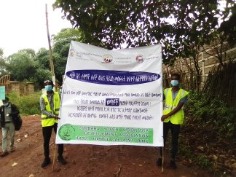
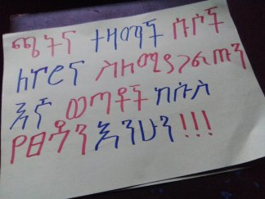
Image 1.3. awareness raising banners by Zumbara art club

Slide 16
1.7. Safe guarding policy implementation
As of PEDO we have prepared and erected secret boxes, safe-guarding policy focal person, Safe guarding policy guide line, Consent letter, and contact information in PEDO project office. Under the safe-guarding policy we also have formed a committee to open secret boxes every week. In addition to this, PEDO staffs have signed code of conduct as well as we are creating awareness about the importance of safe guarding policy.
Based on this we have been prepared safe guarding policy consent form to be signed by our stake holders when they are coming to our project office and when visiting our activities and our volunteer youths. This is used to prevent the violation of our safe guarding policy and it is also important to implement the safe guarding policy.

Slide 17
Cont…
We check the safe guarding policy every Monday at the end of the week. This is done by our safe guarding policy focal person and the committee evaluates weather there is violation of rights at the project staffs or our beneficiaries and the, if the case is managed by the committee it will be managed by the committee or if the case is above the mandate of the committee it will be referred to the board of the organization to be managed.

Slide 18
Challenges
COVID 19 pandemic: The pandemic challenged us not to conduct our activities on time.
Low commitment of some stake holders
Measurements taken for the challenges
We conducted some of the project activities by contacting our stake holders and project advisory committees individually and by tell phone contact

Slide 19
Key priorities and anticipated changes for the next period
Advocate for the creation of one addiction aid recovery centers and institutions to be established, strengthened and/or integrate the service
Strengthen the established committee for the implementation of community by law of ckat ad its associate drugs,
Advocate and lobby the concernced government officials how to adopt community by laws on khat and associate drug addictions.

Slide 20
Lesson learnt
We have seen the importance of different stake holders engagement in general.

Slide 21
Thank You For your Attention !

